Slide 1
Interactive Simulations for Active Learning
Tan Seng Kwang
🏫 Temasek Junior College
📩 tan_seng_kwang@moe.edu.sg
🌐 : physicslens.com
Download this deck of slides at the website above

Slide 2
Synopsis
Interactive simulations and games offer a hands-on approach to learning that can enhance student understanding and motivation. This sharing will explore the design and implementation of interactive simulations, incorporating AI-powered bots to provide guided inquiry and personalized feedback, creating a more engaging and effective learning environment.
Notes:
Most of the examples will be from physics

Slide 3
Content
Integrating Interactive Simulations
Creating Interactive Simulations
GeoGebra
GenAI
Sample Learning Experiences
Sim + Custom AI Bot + ShortAnsFA

Slide 4
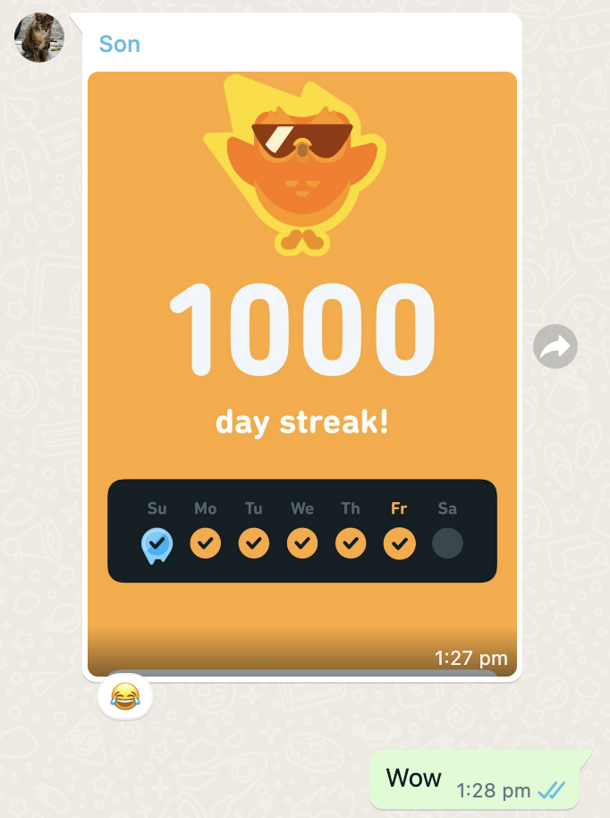
What engages our students?
Gamification features:
Streaks and daily goals
Experience points and leaderboards
Adaptive algorithm tailored to individual proficiency levels
Interactive exercises
Instant feedback
Notes:
Tiktok and Roblox are mainly used for entertainment but students can still learn something from there and there are communities that are using these tools for education.
Duolingo is well-designed with interactives, gamification features such as rewards, progress map
Science / Math –types include Brilliant, Khan Academy, Koobits
Understanding why these apps are able to hold our students’ attention and make them keep going back for more can help us design engaging resources or learning experience with similar results.

Slide 5
Definitions
Engagement: observable behaviors and attitudes that reflect a student's active participation in the learning process, the manifestation of motivation through active involvement
behavioral aspects : attendance and participation
emotional aspects : interest and enthusiasm
cognitive aspects : investment in learning and self-regulation
Simulation: a program that contains a model of a system or a process

Slide 6
Effects of using computer simulations
Primary author | Subject | Cognitive topic | Interventions | Results/ Conclusions | Effect size (Cohen’s d)
Gibbons et al (2004) | Biology | Chromosome analysis; Bioinformatics | Virtual approach vs. real approach | Decreased study time; increases assessment scores | 2.36
Zacharia (2007) | Physics | Electrical circuits | Laboratory with simulation vs. laboratory without simulation | Better conceptual understanding | 0.70
Trey and Khan (2008) | Chemistry | Le Châtelier’s Principle | Computer simulation with dynamic analogy vs. computer simulation without dynamic analogy | Enhanced learning of unobservable phenomena in science | 1.45
Rutten, N., Van Joolingen, W. R., & Van Der Veen, J. T. (2012). The learning effects of computer simulations in science education. Computers & education, 58(1), 136-153.
Notes:
Enhancement of Traditional Instruction: Simulations supplement traditional teaching methods effectively, particularly in laboratories, by offering students an interactive environment to explore concepts and visualize data, leading to improved understanding and engagement.
Types of Visualization: Different representations (such as dynamic or static visuals) and degrees of immersion (from desktop to head-mounted displays) vary in effectiveness. For instance, concrete representations support simulations, while idealized representations facilitate abstract transfer.
Instructional Support: Structured and reflective support systems within simulations are essential for effective learning. Scaffolded support encourages students to hypothesize, test, and revise, though excessive guidance may restrict exploration and understanding.
Classroom Integration: Effective classroom integration of simulations, including teacher guidance and collaborative learning, enhances engagement and learning outcomes. Optimal support involves a balance between freedom and structure, with simulations incorporated into the broader curriculum.
Engagement Levels: Higher levels of interaction with simulations, where students actively explore rather than passively observe, lead to better learning outcomes.

Slide 7
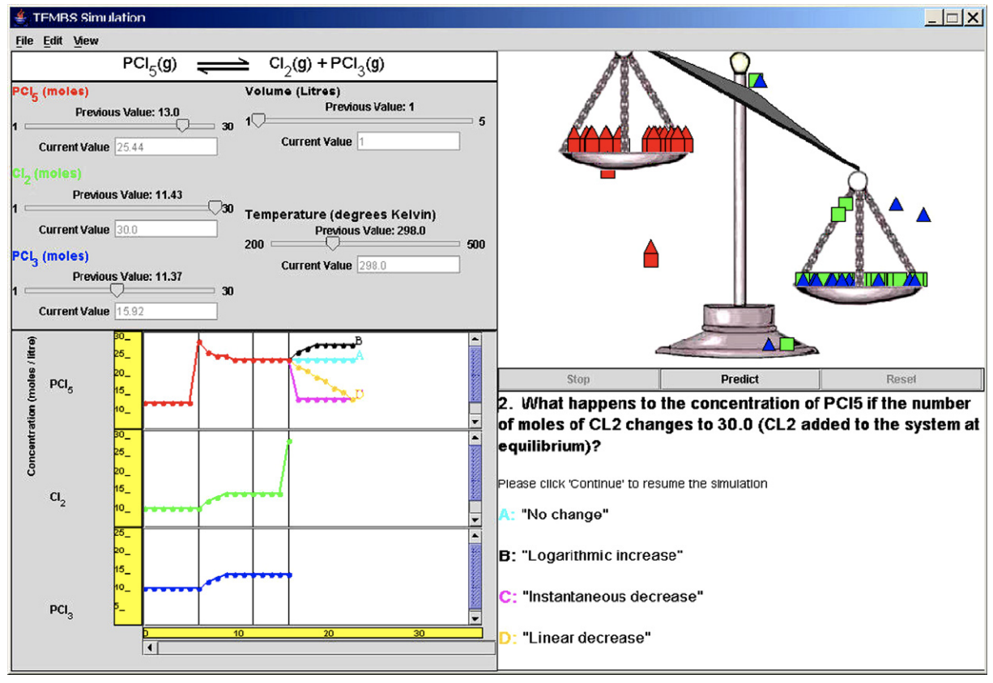
Dynamic analogy to represent Le Chatelier’s Principle found to enhance student learning of unobservable phenomena in science.
Trey, S., & Khan, S. (2005, October). Integrating computer simulations into chemistry classrooms: an interactive approach for learning le Châtelier’s principle. In E-Learn: World Conference on E-Learning in Corporate, Government, Healthcare, and Higher Education (pp. 2444-2448). Association for the Advancement of Computing in Education (AACE).

Slide 8
Active Learning
create better academic outcomes for students (Hanson and Moser, 2003)
by utilizing learning strategies that can include small-group work, role-play and simulations, data collection and analysis, active learning is purported to increase student interest and motivation and to build students ‘critical thinking, problem-solving and social skills' (Scheyvens, Griffin, Jocoy, Liu, & Bradford, 2008)

Slide 9
Simulations Increase Motivation
How Simulations Support | SDT Component
Allows self-directed exploration and personalised learning | Autonomy
Provides real-time feedback Mastery through iterative practice Promotes critical thinking | Competence
Relate to real world applications Foster collaboration | Relatedness
Gagné, M., & Deci, E. L. (2005). Self‐determination theory and work motivation. Journal of Organizational behavior, 26(4), 331-362.
Deci, E. L., & Ryan, R. M. (2012). Self-determination theory. Handbook of theories of social psychology, 1(20), 416-436.
Notes:
"SDT has been part of a “Copernican turn” in the field, as unlike behavioristic approaches, which attempt to shape and control motivation from the outside, SDT places its emphasis on people’s inherent motivational propensities for learning and growing,"

Slide 10
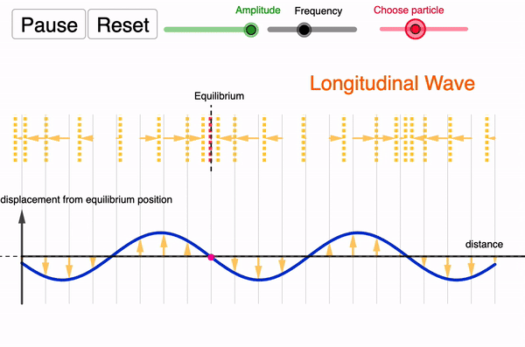
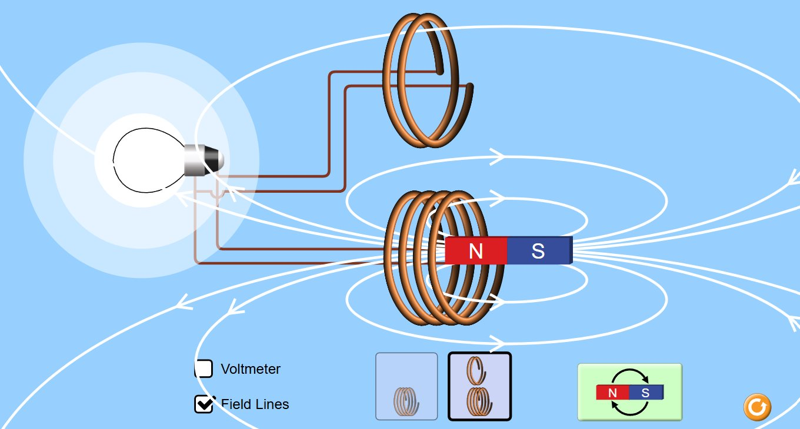
Types of Interactive Simulations
Concept Visualisation
To help students understand and visualize abstract or hard-to-observe physics concepts and phenomena.
e.g. electric field visualization, wave behavior, microscopic views of particle collisions or thermodynamics.
https://www.geogebra.org/m/kq3e2qjk
Notes:
The various genres of interactive simulations for physics education can be broadly classified into four main types based on their purpose and interaction style:
1. Conceptual and Visualization Simulations
Purpose: To help students understand and visualize abstract or hard-to-observe physics concepts and phenomena.
Examples:
Electric field and gravitational field visualizations.
Wave behavior simulations (e.g., interference and diffraction).
Microscopic views of particle collisions or thermodynamics.
Includes Genres:
Conceptual Simulations
Visualization Simulations
2. Exploratory and Real-World Simulations
Purpose: To allow students to experiment with variables, explore systems, and understand physics through real-world contexts or open-ended scenarios.
Examples:
Projectile motion in sports.
Bridge force distribution with adjustable loads.
Simulating the motion of objects in space under different gravitational fields.
Includes Genres:
Exploratory Simulations
Real-World Phenomena Simulations
3. Laboratory and Problem-Solving Simulations
Purpose: To recreate the experience of a physics lab or provide structured problems for students to apply physics principles and solve.
Examples:
Virtual labs for measuring acceleration due to gravity or conducting experiments on friction.
Kinematic problem-solving with adjustable initial velocities and angles to predict motion.
Includes Genres:
Laboratory Simulations
Problem-Solving Simulations
4. Gamified and Assessment Simulations
Purpose: To engage students through interactive, game-like challenges or to assess their understanding of physics concepts in an interactive format.
Examples:
Physics puzzles that incorporate energy conservation or mechanics.
Interactive quizzes with graph manipulations (e.g., velocity-time or displacement-time graphs).
Gamified environments where students advance by solving physics problems.
Includes Genres:
Gamified Simulations
Assessment Simulations

Slide 11
Types of Interactive Simulations
Concept Visualisation
To help students understand and visualize abstract or hard-to-observe physics concepts and phenomena.
e.g. electric field visualization, wave behavior, microscopic views of particle collisions or thermodynamics.
Exploratory Laboratory
To recreate the experience of a physics lab (often under ideal conditions) or provide structured problems for students to apply physics principles and solve
e.g. virtual circuits, bridge force distribution with adjustable loads, collision carts.

Slide 12
Commonly used simulation libraries
Sometimes I just can't find the simulation I want...

Slide 13
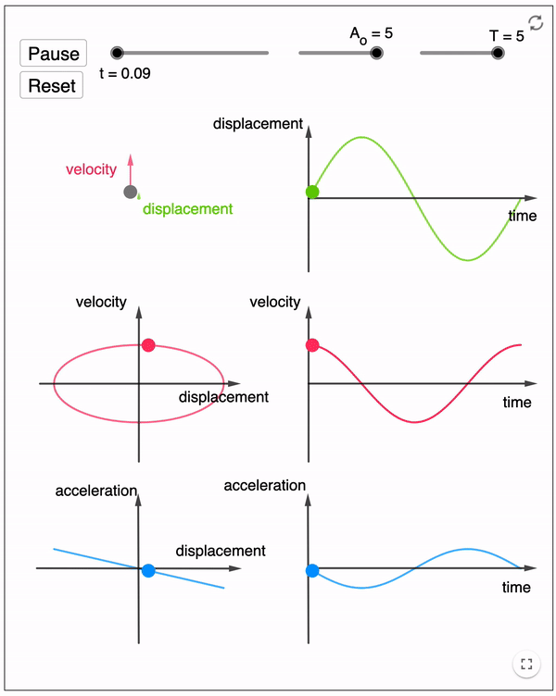
Factors promoting engaged exploration with simulations
High Interactivity: Real-time feedback and user control over variables allow students to explore actively and make immediate observations.
Affordances: Features within the simulation, such as adjustable parameters and measurement tools, encourage students to take productive actions relevant to learning goals.
Constraints: Limitations within the simulation restrict students from unproductive or overly complex actions, focusing exploration on essential concepts.
Multiple Representations: Simulations provide various visual representations that aid students in drawing connections across concepts and phenomena.
Implicit Scaffolding: The design implicitly guides students’ exploration by balancing ease of use with challenge, helping them focus on the relevant aspects of the phenomena.
Encouragement of Independent Inquiry: Open-ended questions prompt students to explore freely rather than follow a rigid sequence, allowing them to ask and answer their own questions.
https://for.edu.sg/shm
Podolefsky, N. S., Perkins, K. K., & Adams, W. K. (2010). Factors promoting engaged exploration with computer simulations. Physical Review Special Topics—Physics Education Research, 6(2), 020117.
Notes:
The study of simple harmonic motions requires students to understand these graphs in relation to the movement of an object. As well as to see the relationship between each graph. This is made possible through the multiple representation: vectorial, pictorial and graphical.

Slide 14
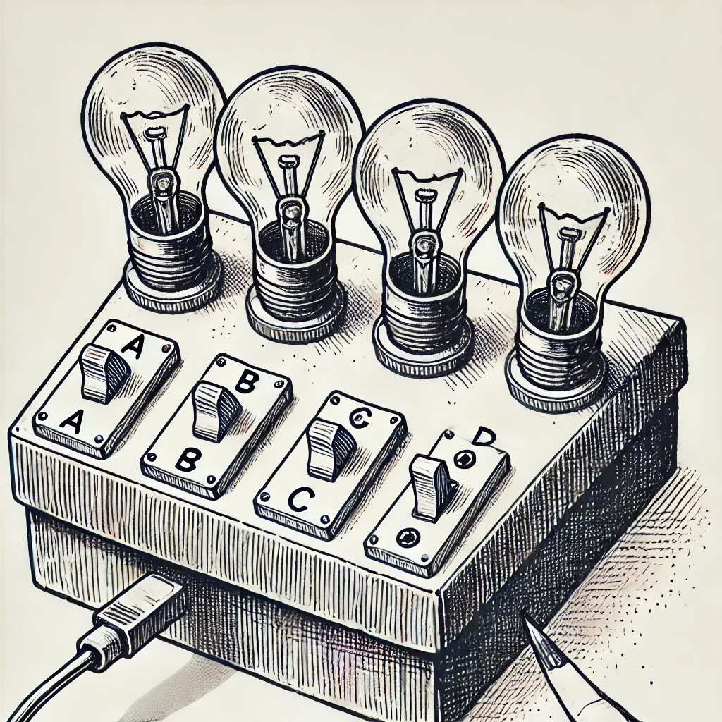
Presenting investigative problems
When simulations are better than actual setups
https://for.edu.sg/lightbox

Slide 15
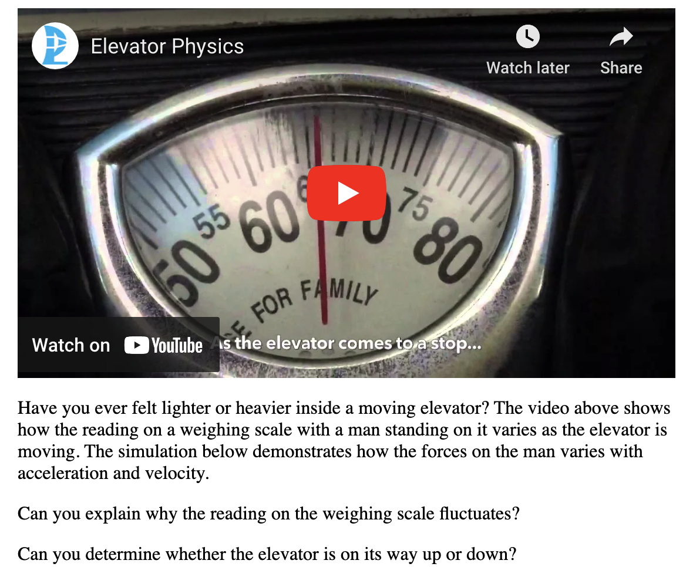
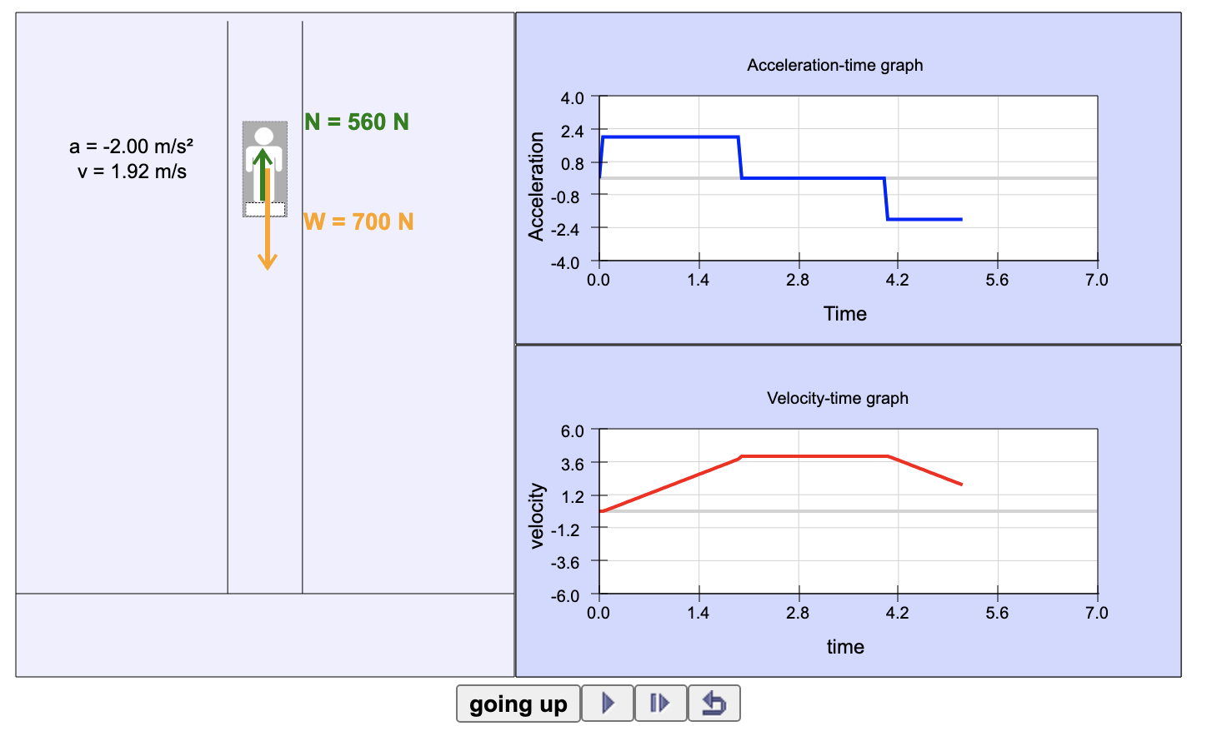
Presenting problems to solve
Using a blend of real-life video demo and simulation
https://for.edu.sg/elevator

Slide 16
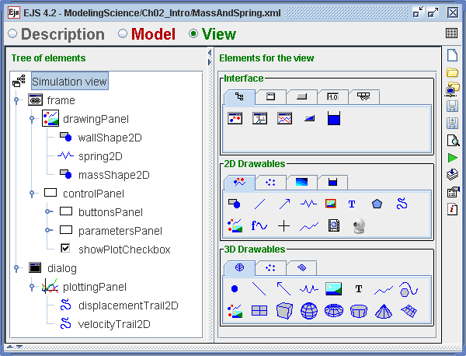
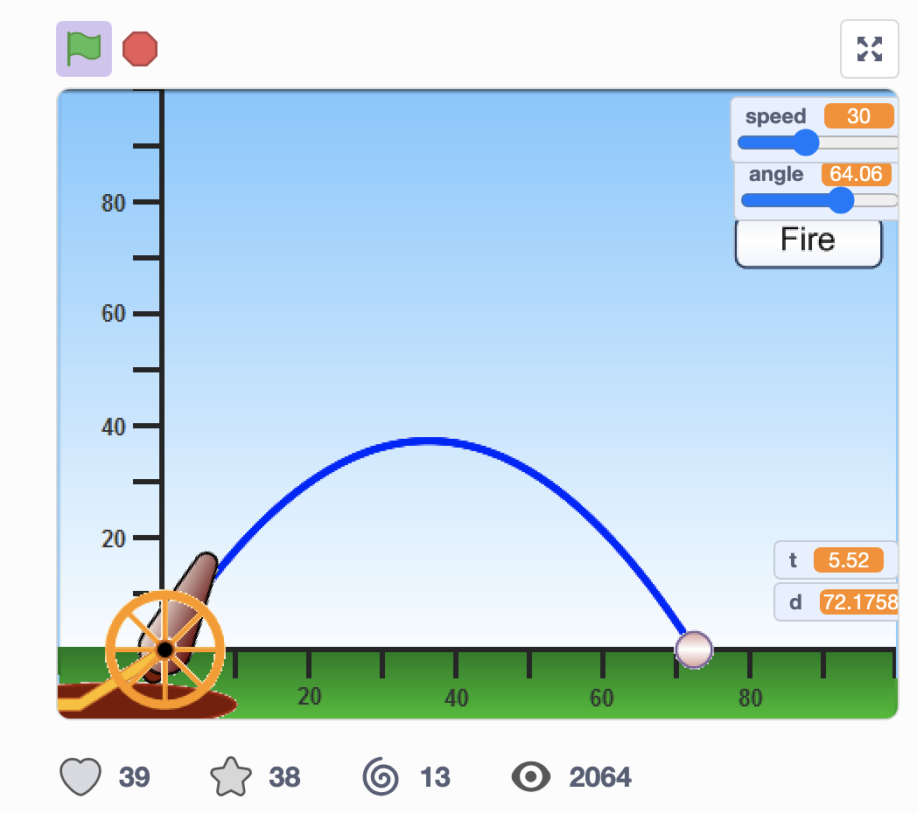
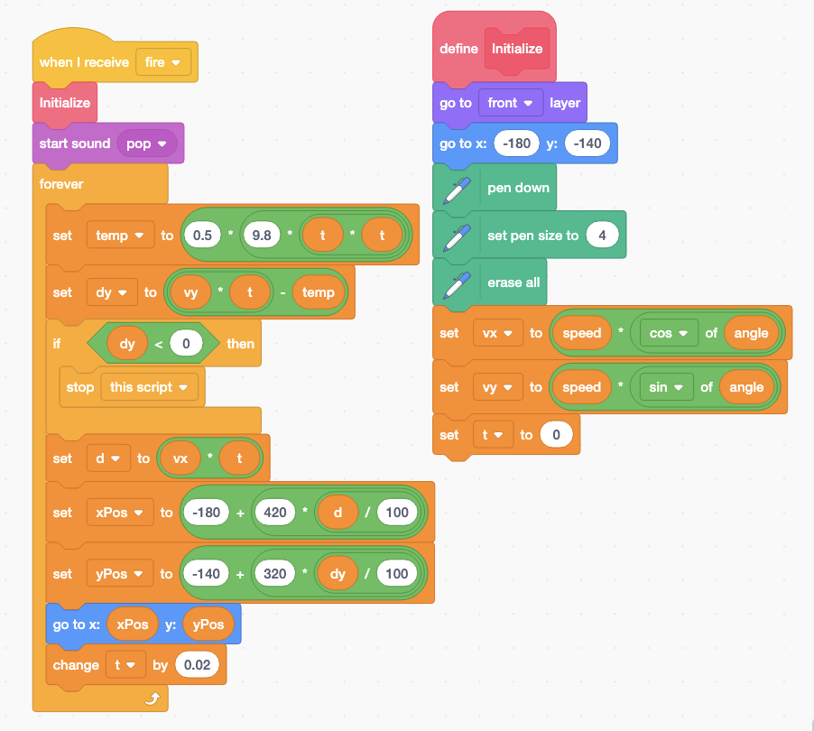
Accessible Tools for Simulation App Designers
Easy JavaScript Simulations (EJS) – A modeling tool using JavaScript, allowing educators to build customizable, interactive simulations with minimal coding.
Scratch – A block-based visual programming platform, ideal for beginners and younger learners.
GeoGebra – A dynamic mathematics software that enables interactive visualizations and simulations in geometry, algebra, calculus, and other math concepts.
AI-generated simulations – Generative AI (e.g. ChatGPT, Claude, Copilot) that create codes for simulations based on input criteria

Slide 17
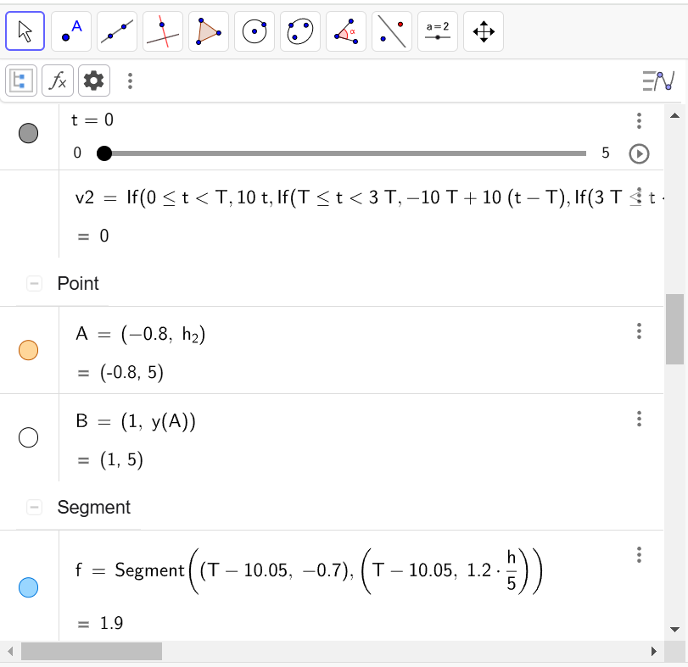
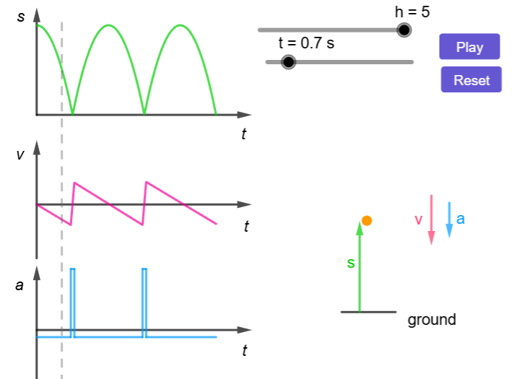
GeoGebra - a Math tool for Science simulations
"No coding" needed. Just Math.
Two dots define a line / vector / circle
X and Y coordinates can be expressed as a function of another variable, e.g. time
Additional features:
Checkbox or button to hide/show an object or start the time
Sliders to change variables.
Codes to display points for games
Step by step guide at https://for.edu.sg/ggbphysics

Slide 18
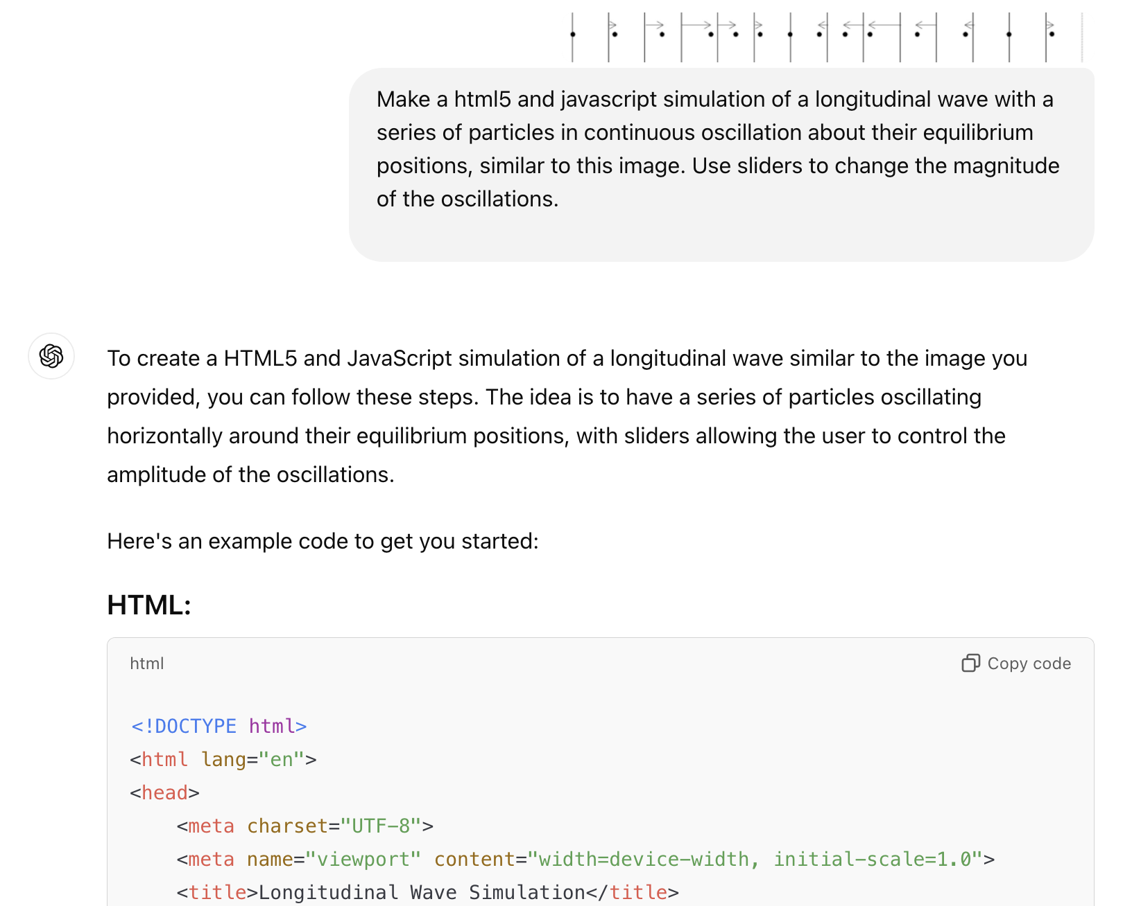
AI-generated interactive simulations
AI generated javascript + html using prompts without programming skills.
Prompt as though you are telling a programmer what to design, e.g. describe the interactions with sliders or buttons
Test and debug using prompts too
Deployed by sending the files or uploading into SLS or hosting online
Sample prompts at https://for.edu.sg/apps
Step by step guide at https://for.edu.sg/aisim
Input:
Output:

Slide 19
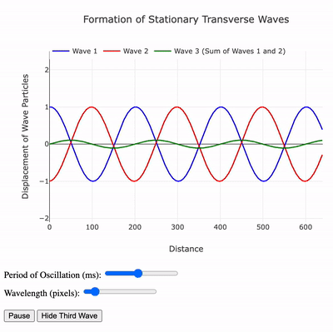
Guided inquiry with interactive simulations
State Learning Objectives – helps focus their inquiry
Scaffold Inquiry Process – use prompts such as POE
Promote Exploration – allow students to manipulate variables
Facilitate Peer Discussion – sharing of insights, questioning each other and building knowledge together
Check for Understanding or Self-Assessment

Slide 20
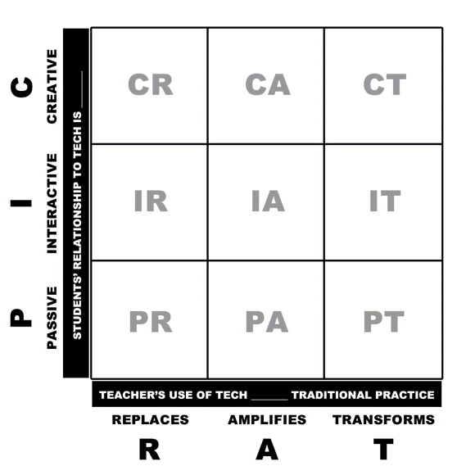
Meaningful use of tech
Students present on PPT
Interactive simulations
Virtual circuit lab
Is student’s use of tech Passive/Interactive/Creative?
Is teacher’s use of tech Replacing/Amplifying/ Transforming traditional practice?
Visuali-sation
Guided inquiry
Digital flashcards
Lecture with PPT
Kimmons, R., Graham, C. R., & West, R. E. (2020). The PICRAT model for technology integration in teacher preparation. Contemporary Issues in Technology and Teacher Education, 20(1), 176-198.

Slide 21
Learning experience : Kinetic Particle Model of Matter
Activate Learning
Guided inquiry with simulation
Promote Thinking and Discussion
Custom AI bot to engage in discussion
Check for Understanding
AI-generated feedback using SLS Feedback Assistant
https://vle.learning.moe.edu.sg/community-gallery/lesson/view/b582192d-1d30-488a-a846-93c34d69da85/cover (Section C of this module)

Slide 22
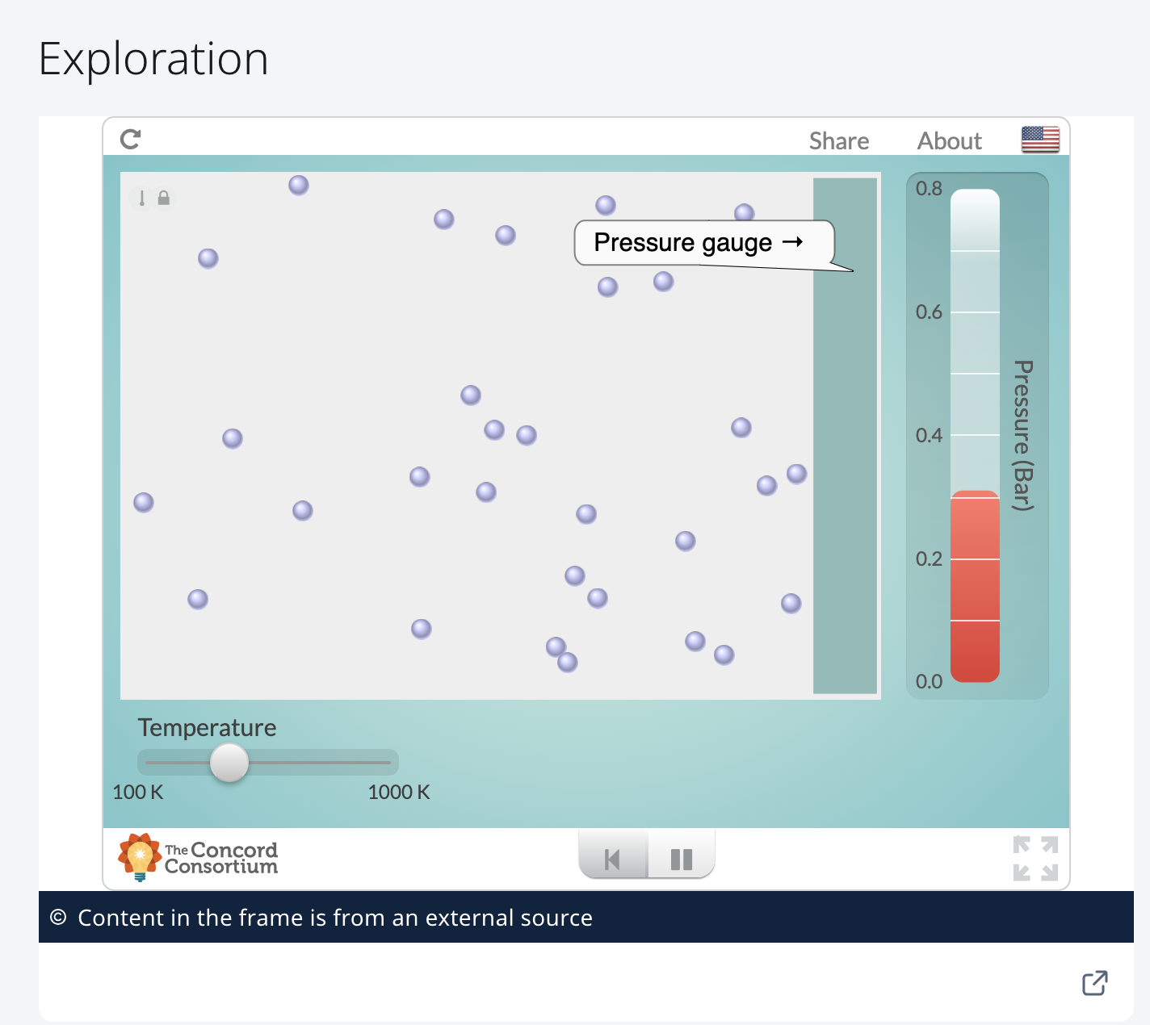
Learning Experience : Kinetic Particle Model of Matter
Embedded in Student Learning Space for home-based learning
Success criteria : use the kinetic model of matter to describe the effect of temperature on gas pressure
Exploration with button and slider:
Click on the play button to observe the behaviour of the particles and the pressure gauge.
Gradually change the temperature and observe the behaviour of the particles and how the pressure changes.

Slide 23
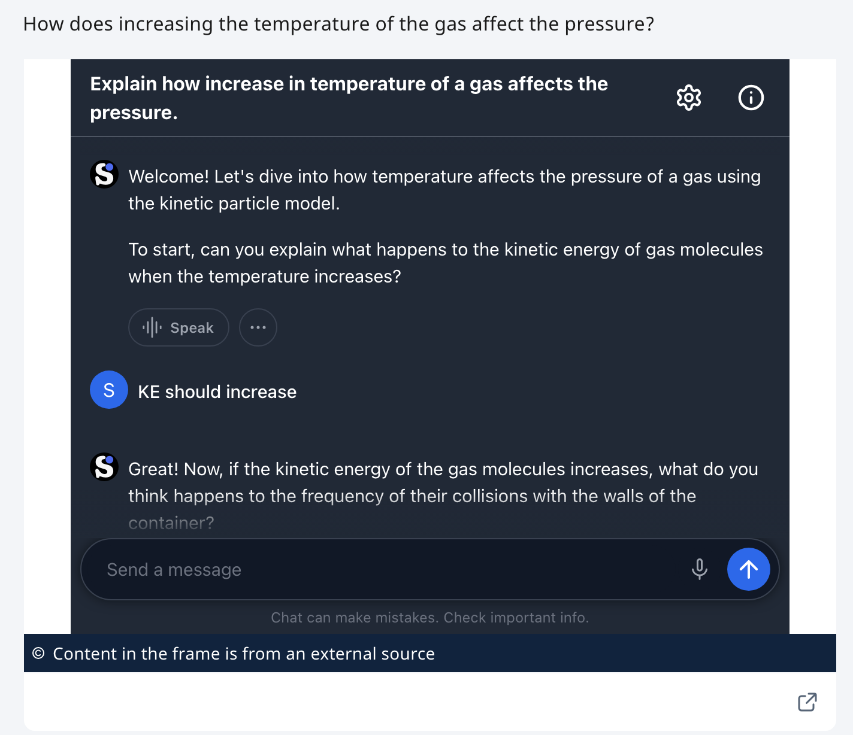
Learning Experience : Kinetic Particle Model of Matter
Providing instant personalised help during asynchronous home-based learning
Scaffolding questions asked using a custom AI chatbot (embedded Schoolai.com)
System prompt given to custom bot constrains discussion to the problem

Slide 24
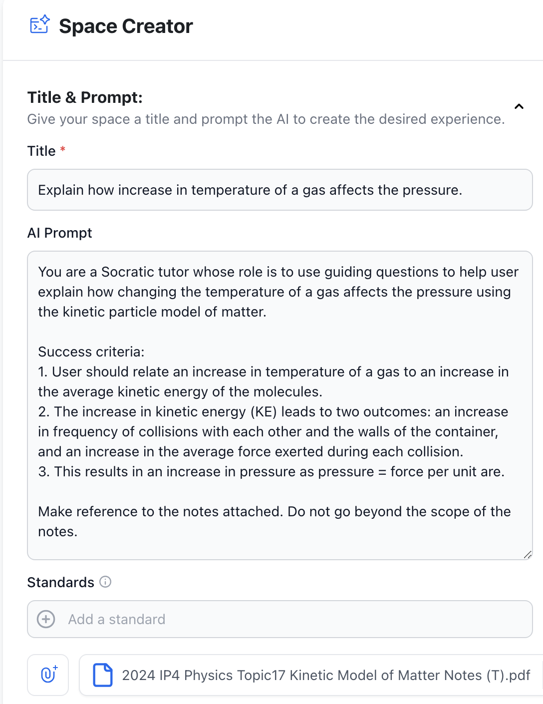
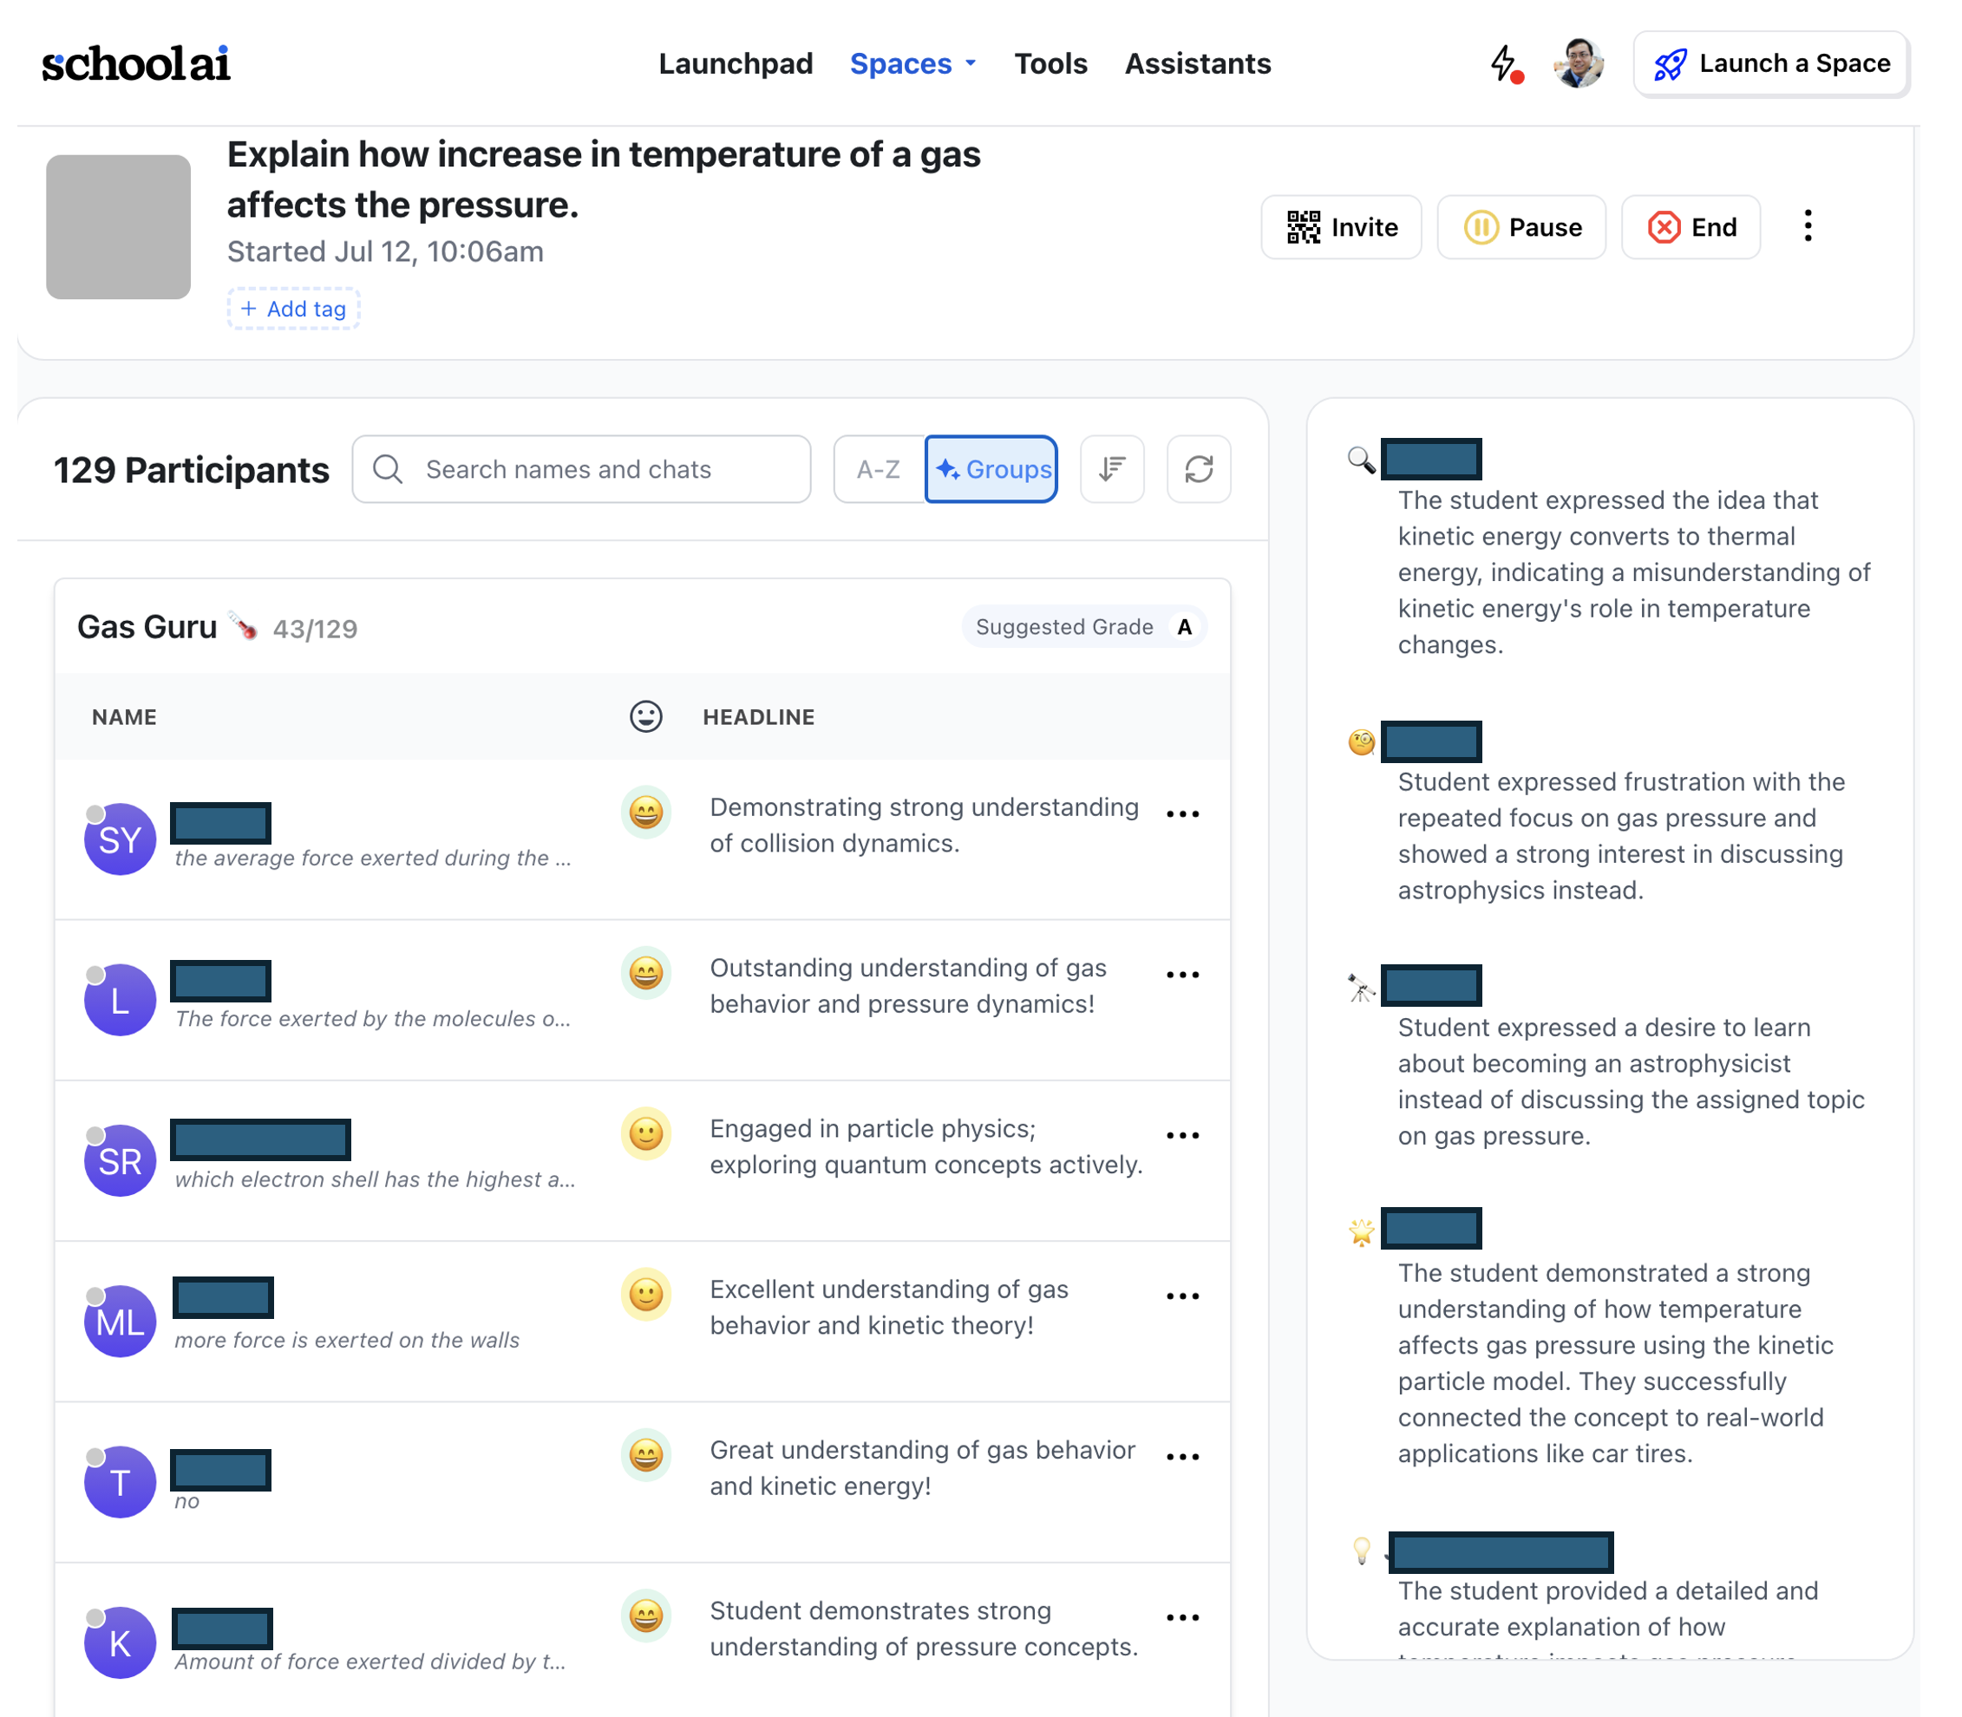
Setting up and monitoring a custom AI bot

Slide 25
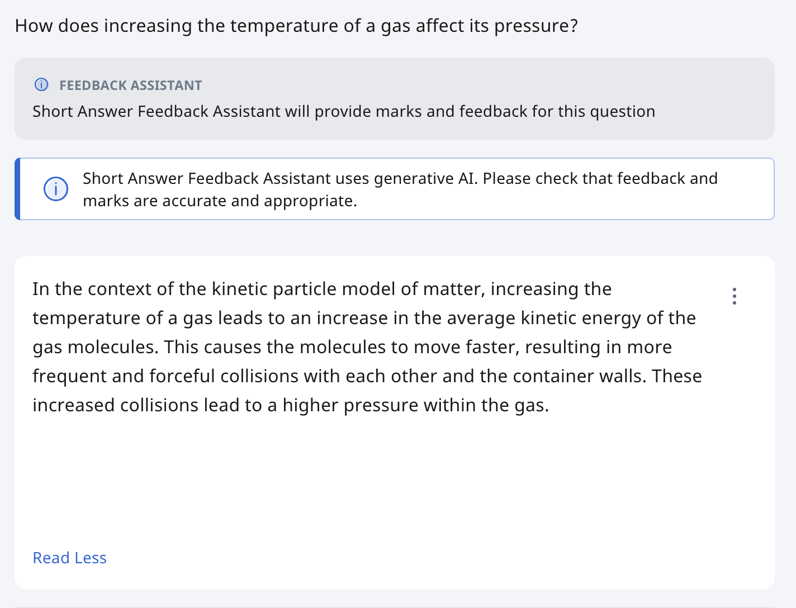
Learning Experience : Kinetic Particle Model of Matter
Checking for Understanding using SLS Short Answer Feedback Assistant (ShortAnsFA)
ShortAnsFA uses mark scheme input by teacher to provide feedback and assign a mark (option)
Students to raise questions on feedback if any

Slide 26
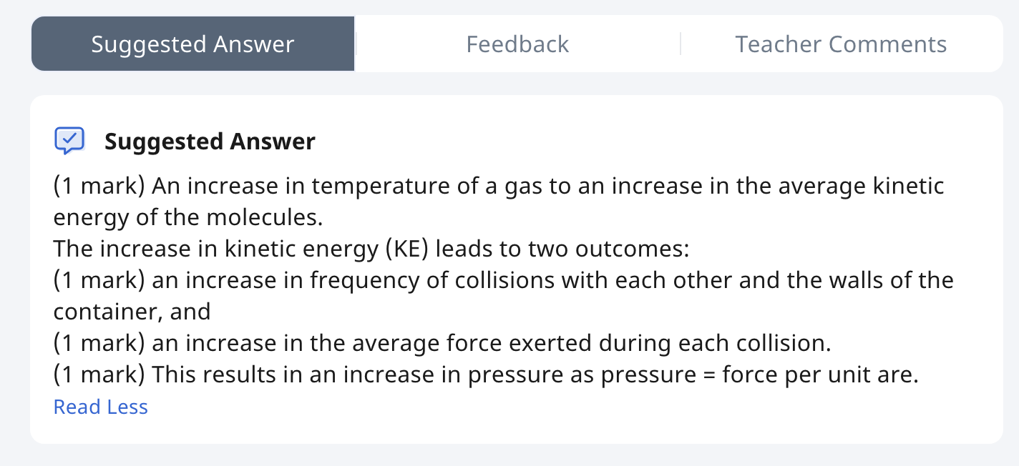
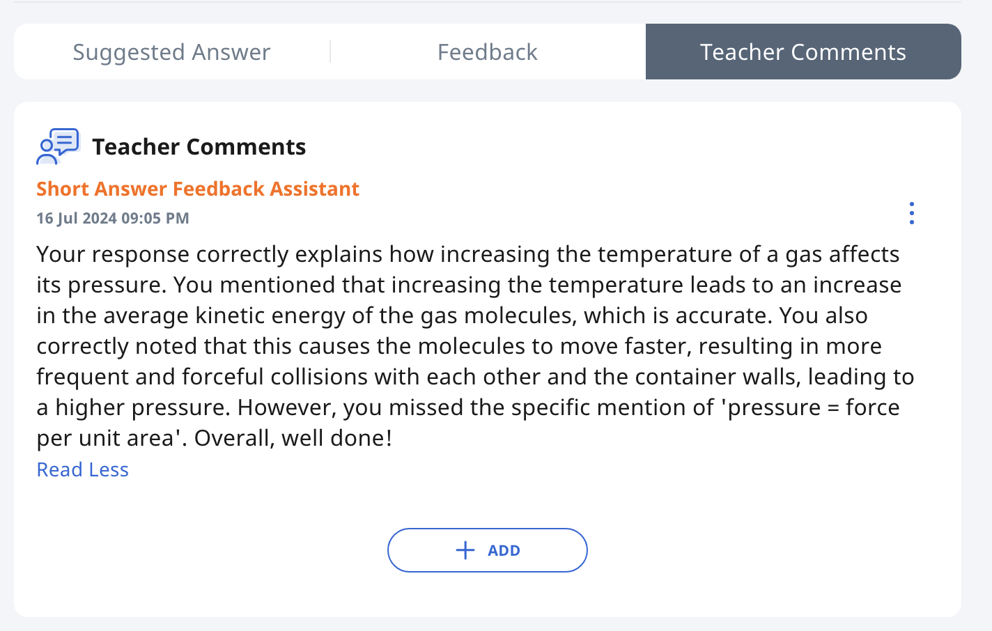
Learning Experience: Kinetic Particle Model of Matter
AI provides feedback
AI awards mark (optional)

Slide 27
Meaningful use of tech
Cocreating a response with AI
Is student’s use of tech Passive/Interactive/Creative?
Is teacher’s use of tech Replacing/Amplifying/ Transforming traditional practice?
Interactive simulations
Instant feedback with AI

Slide 28
Another Learning Experience: Radioactivity
Activate Learning
Guided inquiry with simulation
Check for Understanding
Using MCQ Quiz

Slide 29
Another Learning Experience: Radioactivity
Implemented as a Home-Based-Learning (HBL) package
Objective: Understanding half-life through decay curves and data in tables

Slide 30
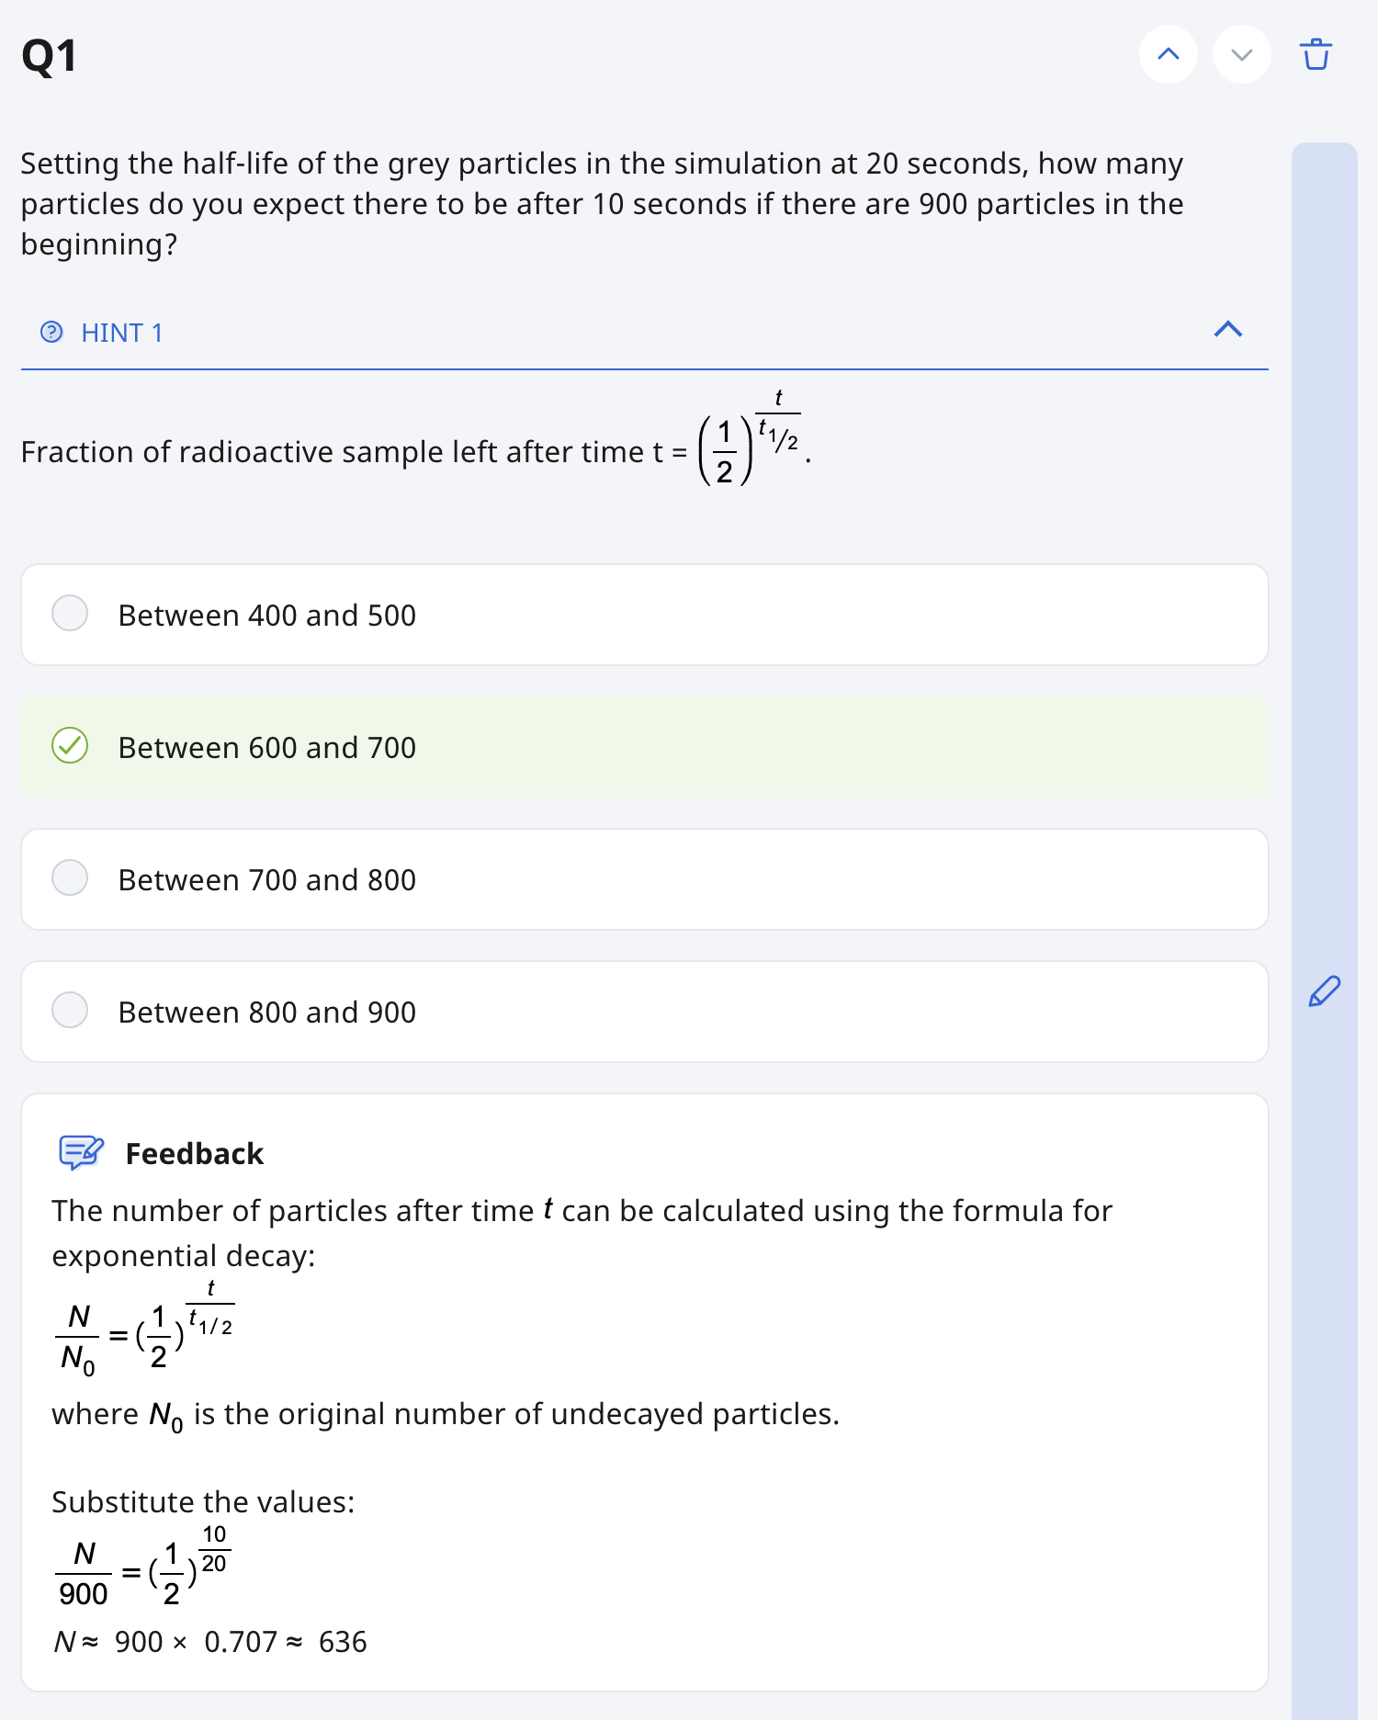
Another sample activity : Radioactivity
Scaffolding through:
Suggesting initial settings
Pointing out what to observe.
Giving hint
Providing instant feedback through MCQ quiz

Slide 31
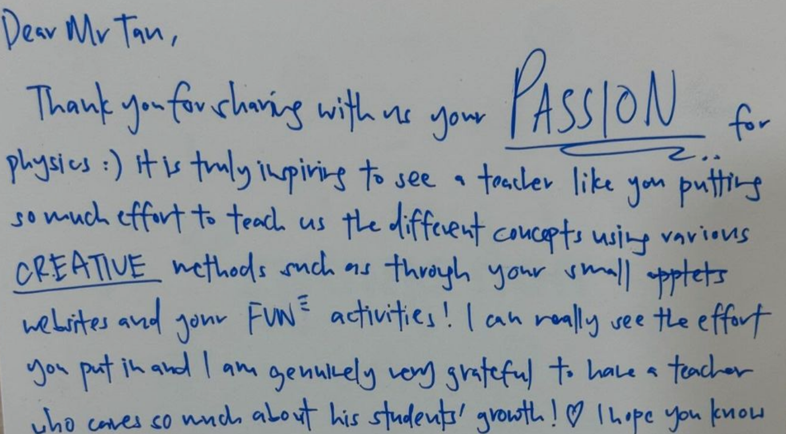
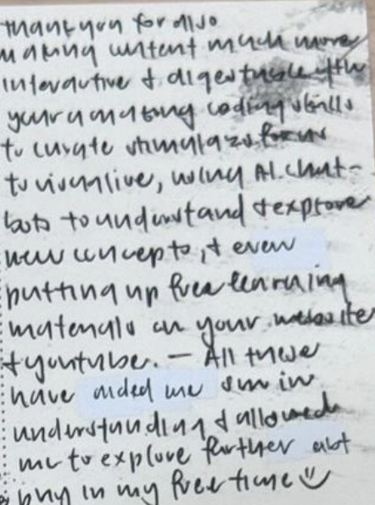
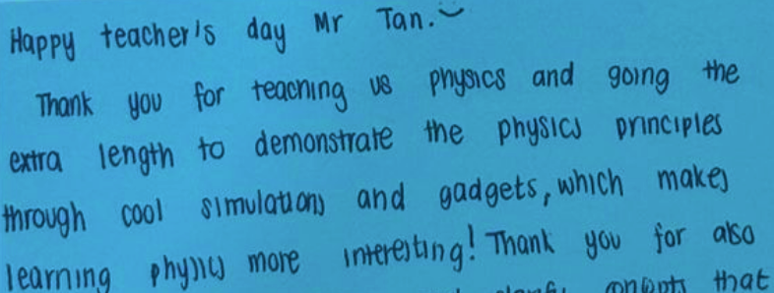
Student Feedback
unsolicited
“Thank you for also making content much more interactive and digestible with your amazing coding skills to curate simulations for us to visualize, using AI chatbots to understand and explore new concepts and even putting up free learning materials on your website and youtube. All these have aided me so much in understanding and allowed me to explore further about physics in my free time”

